Slide 1
WorkshopPLUS Power Platform for Administrators
Power Platform Licensing
Notes:
Workshop Version: 2.6

Slide 2
Conditions and terms of use
© Microsoft Corporation. All rights reserved.
You may use these training materials solely for your personal internal reference and non-commercial purposes. You may not distribute, transmit, resell or otherwise make these training materials available to any other person or party without express permission from Microsoft Corporation. URL’s or other internet website references in the training materials may change without notice. Unless otherwise noted, any companies, organizations, domain names, e-mail addresses, people, places and events depicted in the training materials are for illustration only and are fictitious. No real association is intended or inferred. THESE TRAINING MATERIALS ARE PROVIDED “AS IS”; MICROSOFT MAKES NO WARRANTIES, EXPRESS OR IMPLIED IN THESE TRAINING MATERIALS

Slide 3

Objectives
After completing this Learning, you will be able to:
 | 1 | Understand license plans for…. Power Apps Power Automate Power Pages Power Virtual Agents
 | 2 | Understand…. Capacity Add-Ons

Slide 4
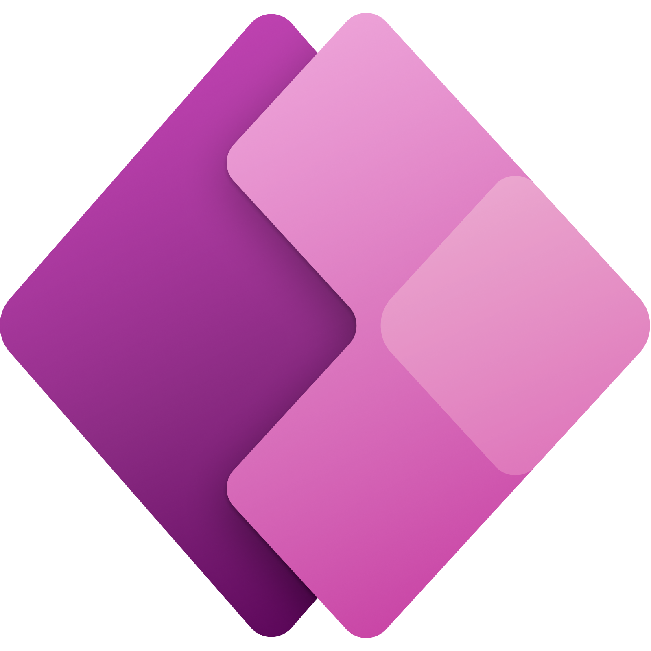
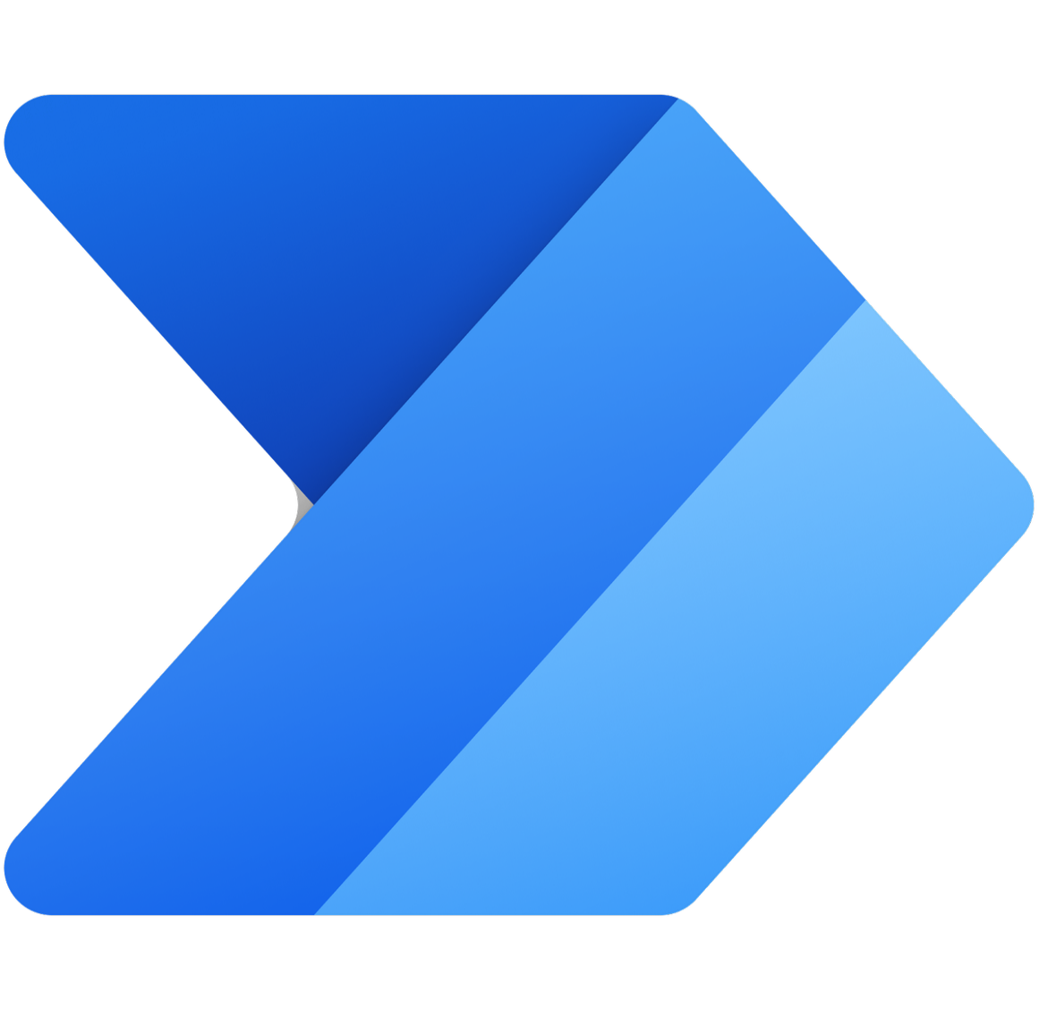


Recommended offers
Power Apps
Application Development
Power Automate
Workflow Automation
Microsoft Copilot Studio
Build copilots
Power Pages
Web App Development
Premium
Premium
$15 per user / month
Per tenant capacity
Capacity packs
$20 per user / month
$200 for 25,000 messages
per tenant / month
Tier 3 (100k+ users):
$50 for 100
authenticated users / month
or $25 for 500
anonymous users / month
Process
$150 per bot / month
Process Mining
$5,000 per 100 GB of
data stored / month
Notes:
Requests in Microsoft Power Platform consist of various actions that a user makes across various products. At a high level, below is what constitutes an API request:
Power Apps – all API requests to connectors and Microsoft Dataverse.
Power Automate – all API requests to connectors, process advisor analysis, HTTP actions, and built-in actions from initializing variables to a simple compose action. Both succeeded and failed actions count towards these limits. Additionally, retries and other requests from pagination count as action executions as well. For more information, see What counts as Power Platform request?
Power Virtual Agents - API requests (or calls) to Power Automate flows from within a chatbot conversation.
Dataverse – all create, read, update, and delete (CRUD), assign, and share operations including user-driven and internal system requests required to complete CRUD transactions, and special operations like share or assign. These can be from any client or application (including Dynamics 365) and using any endpoint (SOAP or REST). These include, but aren't limited to, plug-ins, classic workflows, and custom controls making the earlier-mentioned operations.

Slide 5
Power Apps License Plans

Slide 6
Power Apps standalone plans
RECOMMENDED MOTION
Power Apps Premium
Power Apps per app
pay-as-you-go
Power Apps per app
Entitles user to unlimited apps and websites
$20 per user (or $12 per user w/2,000+ new licenses)
Entitles user to 1 app or website
$5 per user/month
Entitles user to 1 app
$10 per active user/app/month
Build, modernize, and deploy unlimited applications for your team, department, or entire organization;
Best for businesses that want one license for users, regardless of the number of apps they need to run or websites they access
Best for businesses that want to license users for each app they run or website they access, with the flexibility to stack licenses for additional apps and websites.
Best for businesses that want to pay-as-you-go for only the users who access a Power App one or more times in a month
Power Apps & Power Automate for Office 365 and Dynamics 365 allow users to customize & extend Office 365 and Dynamics 365 applications. For more information, please see Office 365 / Dynamics 365 sections in this deck.
Notes:
Page = Power Page

Slide 7
Summary of Power Apps
 |  | ^{Power Apps} ^{subscription} | ^{Power Apps} ^{Special FLW Offer} | ^{Power Apps} ^{subscription} | ^{Power Apps per app} ^{pay-as-you-go} | ^{Power Apps use rights} ^{included with:}
 |  | RECOMMENDED MOTION Power Apps Premium ^{$20 per user/month} ^{(or $12 per user/month} with 2K+ new per user licenses) | Power Apps per user for Frontline Workers¹ ^{$3 per user/month} ^{(Lead Status)} | Power Apps per app ^{$5 per user/month} | Power Apps per app meter² ^{$10 per active user/app/month} | Select D365 Pro & Enterprise licenses³ | Select Microsoft 365 and Office 365 licenses
Plans | Capabilities
Power Apps | Run custom apps | Unlimited apps | Unlimited apps | 1 app or 1 website | 1 app | Within same environ. as licensed D365 application(s)⁴ | Unlimited
 | Run custom websites | Unlimited websites | Unlimited websites | Unlimited websites
 | Run workflows within the custom app⁵ | ⁶ | ⁶ | ⁶ | ⁶ | ⁶ | ●
AI Builder | Service credits⁷ | 500 credits | 0 credits | 250 credits
Power Platform connectors | Standard connectors | ● | ● | ● | ● | ● | ●
 | Premium and custom connectors | ● | ● | ● | ● | ●
 | On premises and cloud services data transfer | ● | ● | ● | ● | ●
Dataverse | Full Dataverse access | ● | ● | ● | ● | ● | Dataverse for Teams only
 | Create and access custom tables^{8,9} | ● | ● | ● | ● | Pro limited to 15 per app
 | Dataverse Database capacity (Accrued) | 250 MB¹⁰ | 0 MB | 50 MB¹⁰
 | Dataverse File capacity (Accrued) | 2 GB¹⁰ | 0 MB | 400 MB¹⁰
Managed Environments | Admin and governance at scale¹¹ | ● | ● | ● |  | ^{6,12}
¹ Power Apps per user for FLW Requirements: 1) Licensed FLW user must meet the requirements for License Eligibility for Frontline Worker (FLW) Licenses per the
Microsoft Product Terms, 2) Customer must own equivalent amounts of F-SKU licenses (MF1/MF3/OF3), 3) Minimum purchase of 2,000 licenses is
required. The Power Apps per user FLW SKU available in lead status until January 1, 2024, via EA and EAS.
² Environments that are configured to use Power Platform pay-as-you-go, receive a one-time entitlement of 1 GB of Dataverse
Database capacity and 1 GB of Dataverse File capacity per environment. Additional Dataverse Database, Dataverse File and
Dataverse Log capacity can be purchased in increments of 1 GB.
³ For exceptions to Dynamics 365 Field Service use rights for Power Apps users, refer to the Dynamics 365 Licensing Guide.
⁴ Dynamics 365 Pro does not have use rights for Power Apps or Power Pages
⁵ Power Automate use rights included with Power Apps do not include RPA functionality, which requires a separate purchase of Power Automate Premium.
⁶ Within app context
⁷ Cap on accrued capacity: 1,000,000 credits per tenant. For more AI Builder service credits, use the AI Builder capacity add-on.
⁸ For Power Apps use rights with restricted tables and exceptions for case tables, see Restricted tables requiring Dynamics 365 licenses.
⁹ For exceptions to Dynamics 365 Field Service use rights for Power Apps users, refer to the Dynamics 365 Licensing Guide.
¹⁰ Dataverse Database and Database File capacity entitlements accrue at the tenant level. Additional Dataverse Database, Dataverse File and
Dataverse Log subscription capacity can be purchased in increments of 1 GB via the Dataverse capacity add-ons.
¹¹ When Managed Environments is activated in a specific environment, all Power Apps, Power Automate, Power Virtual Agents, and Power Pages usage in that environment requires standalone licenses. Please review Power Platform Managed Environments for more details.
¹² Managed Environments is not included with Dynamics 365 Pro licenses.
Notes:
Requests in Microsoft Power Platform consist of various actions that a user makes across various products. At a high level, below is what constitutes an API request:
Power Apps – all API requests to connectors and Microsoft Dataverse.
Power Automate – all API requests to connectors, process advisor analysis, HTTP actions, and built-in actions from initializing variables to a simple compose action. Both succeeded and failed actions count towards these limits. Additionally, retries and other requests from pagination count as action executions as well. For more information, see What counts as Power Platform request?
Power Virtual Agents - API requests (or calls) to Power Automate flows from within a chatbot conversation.
Dataverse – all create, read, update, and delete (CRUD), assign, and share operations including user-driven and internal system requests required to complete CRUD transactions, and special operations like share or assign. These can be from any client or application (including Dynamics 365) and using any endpoint (SOAP or REST). These include, but aren't limited to, plug-ins, classic workflows, and custom controls making the earlier-mentioned operations.

Slide 8
Power Apps Premium
Overview
Allows licensed users to run unlimited custom applications (both canvas and model driven).
Offer Details
License overview | Provides use rights to unlimited custom apps and pages for 1 user
Pricing | $20 per user/month
License overview | Provides use rights to unlimited custom apps and Power Pages for 1 user
Daily Power Platform requests¹ | 40,000 per licensed user / 24h

Slide 9
Power Apps per app plan overview
App definition
An “app” is a combination of Power Platform assets that solves a specific business scenario.
Each “per app” license provides use rights to 1 app or 1 portal
No limits on other components (e.g., forms, dashboards, etc.)
Offer Details
SKU Name | Power Apps per app
List pricing | $5 per user for 1 app or Power Page website
License assignment | In product – Power Platform Admin Center
Stackable? | Yes
Daily Power Platform Requests | 6,000
When to position the Power Apps per app plan
Customer prefers to get started with specific business scenarios before going all in on the platform
Customer wants to license a subset of users for a few specific apps

Slide 10
Power Apps per app pay-as-you-go (PAYG)
Power Apps per app pay-as-you-go
Entitlements: Dataverse database (1 GB) and file (1 GB) capacity entitlements are applied to each environment with pay-as-you-go billing enabled and are not granted for each monthly active user.
$10 per active user per app/month
Dataverse capacity add-on meters:
Dataverse Database capacity – $48 per GB/month
Dataverse File capacity – $2.40 per GB/month
Dataverse Log capacity – $12 per GB/month
More information about how meters work.
Best for businesses that want to license active users for each app¹ they run and pay later based on consumption
¹Power Apps per app pay-as-you-go meter entitles licensed user to run 1 app or 1 page
Power Apps & Power Automate for Office 365 and Dynamics 365 allow users to customize & extend Office 365 and Dynamics 365 applications. For more information, please see Office 365 / Dynamics 365 sections in this deck.

Slide 11
Power Automate License Plans

Slide 12
Power Automate
v
.
RECOMMENDED MOTION
Power Automate Premium
RECOMMENDED MOTION
Power Automate
Process
RECOMMENDED MOTION
Process Mining
add-on
Power Automate Hosted RPA
add-on
Power Automate unattended RPA
add-on
Power Automate
unattended desktop flow run meter
Power Automate
cloud flow or attended desktop flow run meter
$15 per user/month
$150 per bot/month
$5,000 per
100 GB of data stored/month
$215 per bot/month
$150 per bot/month
$3.00 per
flow run
$.60 per
flow run
Enables licensed users to automate modern applications via API-based digital process automation (cloud flows) and legacy applications via UI-based robotic process automation (desktop flows) in attended mode
Licenses a single ‘automation’ bot that can be used for unattended desktop automation (robotic process automation, RPA) OR a digital process automation (DPA) flow that can be accessed by unlimited users in the organization
Capacity based license that enables rapid
ROI for customers by identifying critical optimization
opportunities and
improving existing
processes. Add-on to Power Automate
Premium
Add-on to Power Automate Premium that allows users to run robotic process automation (RPA) as a service with hosted machine options
Add-on to Power Automate per user or per flow that enables a bot to run autonomously in a local remote desktop or virtualized environment.
Best for businesses that want to pay-as-you-go for each desktop flow run in unattended mode each month
Enables the setup of unlimited bots for concurrent runs
Best for businesses that want to pay as-you-go for each cloud flow run or desktop flow run in attended mode each month

Slide 13

Summary of Power Automate |  | Power Automate subscriptions |  |  | Power Automate use rights included with: |  | Power Automate use rights included with:
 |  | RECOMMENDED MOTION Power Automate Premium $15 per user/month | RECOMMENDED MOTION Power Automate Process $150 per bot/month | RECOMMENDED MOTION Power Automate Process Mining¹ add-on $5,000 per 100 GB of data stored/month | Hosted RPA add-on² $215 per bot/month | Unattended RPA add-on $150 per bot/month | Power Apps | Select D365 licenses | Select M365/O365 licenses | Windows
Plans | Capabilities
Power Automate³ | Cloud flows (Automated, instant, and scheduled flows) | l | l |  |  | l | l⁴ | l⁴ | l
 | Business process flows | l | l |  |  | l | l⁴ | l⁴
 | Attended desktop flows | l |  |  |  |  |  |  |  | l⁵
 | Unattended desktop flows |  | l |  | l | l
Process Mining | Task Mining | l |  | l
 | Cloud flows process mining integration | l |  | l
 | Visualize and analyze processes | l^{6,7} |  | l
Share and collaborate | Other users can view, edit, or run automations | l |  |  |  |  | l | l | l
Power Platform connectors | Standard connectors | l | l |  |  |  | l⁴ | l⁴ | l
 | Premium and custom connectors | l⁸ | l⁸ |  |  |  | l⁴ | l⁴
 | On prem & cloud svcs. data transfer | l | l |  |  |  | l⁴ | l⁴
AI Builder | Service credits⁹ | 5,000 |  |  | 5,000 | 5,000
Dataverse | Dataverse use rights | l | l |  |  |  | l⁴ | l⁴ | Within Teams only
 | Database capacity (Accrued) | 250 MB¹⁰ | 50 MB¹⁰ | 2 GB¹⁰
 | File capacity (Accrued) | 2 GB¹⁰ | 200 MB¹⁰ | 1 TB¹⁰
Managed Environments | Admin and governance at scale¹¹ | l | l |  |  |  | l | l^{4,12}
1 Process Mining qualifying prerequisite: Power Automate Premium. Multiple add-ons can be applied against a single qualifying prerequisite license.
2 Hosted RPA qualifying prerequisites: Power Automate Premium, Power Automate Process and Power Automate per flow. Multiple add-ons can be applied against a single qualifying prerequisite license.
3 See technical documentation for definitions of each flow type.
4 Within app context. For both triggers and actions, flows within an embedding app, can connect to any data source within the use rights of the embedding application and directly with the embedding application
5 Via Power Automate desktop only; a free application not intended for business-critical functions, with no SLA or Microsoft support. cloud flows, standard/premium connectors, orchestration (scheduled or automatic triggers for desktop flows, attended or unattended, combine cloud flows + desktop flows in a single automation), sharing desktop flows, developing in a different environment than the default, Automation Lifecycle Management (ALM), monitoring, execution logs are not included
6 The Power Automate Premium license includes the Process Mining desktop app with advanced analytics and optional Power BI customization with a separate purchase of Power BI. Process Advisor that comes with Power Automate Premium licenses includes out of the box process mining capabilities (pre-built templates) with very limited customization.
7 50 MB of Process Mining data storage per user license, cap on accrued capacity: 100 GB per tenant.
8 Desktop flow connector is included. (This desktop flow connector is not included in Windows licenses.)
9 Cap on accrued capacity 1,000,000 credits per tenant. Additional AI Builder capacity can be purchased per 1M service credits for $500/month via the AI Builder capacity add-on.
10 Dataverse Database and File subscription capacity is pooled at the tenant level. Additional Dataverse Database, Dataverse File and Dataverse Log subscription capacity can be purchased in increments of 1 GB.
11 When Managed Environments is activated in a specific environment, all Power Apps, Power Automate, Power Virtual Agents, and Power Pages usage in that environment requires full licenses.
12 Managed Environments is not included with Dynamics 365 Pro licenses. Please see Power Platform Managed Environments for details.
All pricing subject to change, please consult price list for actual pricing.

Slide 14
Power Automate for M/Office 365 (seeded plan)
Plans and capabilities | Power Automate for M/Office 365
Execute flows | Automated, instant, and scheduled flows | ●
 | Business process flows | -
Connect to your data | Standard connectors | ●
 | Premium and custom connectors | -
 | On-premises data gateway | -
Store and manage data | Utilize Dataverse for Teams (use for flows in Teams only) | Select Office 365 licenses
 | Dataverse (formerly Common Data Service) use rights | -
Per license capacity | Daily Power Platform requests | 6,000
Microsoft Confidential

Slide 15
Power Automate (Flow) within app context
Definition of Flow within app context
For both triggers and actions, Flows included within an embedding application can connect:
To any data source within the use rights of the embedding application
Directly with the embedding application (via built in trigger/action)
Example: Flow embedded within Power Apps
Example: Flow within app context.
Example: Flow NOT within app context.
User with a standalone Power Apps license runs an app that uses SQL DB as the data source and includes Flows that:
Read from OR write to SQL DB.
Use a built-in Power Apps trigger and/or action. For example: Send a push notification to the app.
The same user now also wants to use a Flow that updates an Oracle database and:
Is completely unrelated to the Power Apps app
Does not interact in any way with the Power Apps app (or its data sources)
This user will then require a standalone flow.
NOTE: Flows that are triggered from the app are automatically considered as being in context of the app. If automated or scheduled cloud flows are created to support the app and are in context of an app, link the flow to the apps using a PowerShell script. Once the flow is linked, a dependency is established between the app and the flow, and they can be managed together. More info here.
Microsoft Confidential
Notes:
Also, there is a new command to identify flows that need premium licenses to avoid interruption - https://learn.microsoft.com/en-us/power-platform/admin/power-automate-licensing/faqs#how-can-i-identify-flows-that-need-premium-licenses-to-avoid-interruptions

Slide 16
Power Automate pay-as-you-go (PAYG)
Overview
The meter charges based on the number of flow runs, regardless of how many users have access to the flow
In pay-as-you-go environments flow runs by users with Power Automate per user, per user with attended RPA and by flows with per flow subscription licenses are not charged to pay-as-you-go when usage is within license entitlements.
The Power Automate Unattended add-on and pay-as-you-go meters cannot be mixed, every unattended flow run in the pay-as-you-go environment will be charged to pay-as-you-go.
When to position the Power Automate per flow plan
Best for businesses that want the flexibility to pay only when a flow runs
License by Cloud flow run | License by Desktop flow run (attended) | License by Desktop flow run (unattended)
$0.60 per flow run | $0.60 per flow run | $3 per flow run
Pay for each cloud flow run | Pay for each desktop flow (attended mode) run | Pay for each desktop flow (unattended mode) run
Pay-as-you-go plan overview - Power Platform | Microsoft Learn
pay-as-you-go meter
Microsoft Confidential

Slide 17
Summary of Power Automate for Windows
Plan and Capabilities |  | Power Automate use rights within Windows licenses
Execute flows¹ | Cloud flows (Automated, instant, and scheduled flows) | -
 | Business process flows | -
 | Attended desktop flows | l Via Power Automate desktop² only
 | Unattended desktop flows | -
 | WinAutomation client capabilities | -
Share and collaborate | Applies to flows included in the license | -
Connect to your data | Standard connectors | -
 | Premium and custom connectors | -
 | On premises data gateway | -
Store and manage data | Dataverse (formerly Common Data Service) use rights | -
Enterprise management and security | Centralized administration in PPAC | Basic report³
¹ See technical documentation for definitions of each flow type.
² Power Automate Desktop in Windows is a free application you install on your PC that lets you login and create desktop flows. This application should not be utilized for business-critical functions as there is no SLA or Microsoft support. If Power Automate is business critical, you should purchase the appropriate Power Automate license which includes support.
³ Power Automate desktop flows basic usage reports available via Power Platform Admin Center

Slide 18
Power Pages License Plans

Slide 19
Power Pages plans
RECOMMENDED MOTION Power Pages Authenticated users
RECOMMENDED MOTION Power Pages
Anonymous users
Power Pages Authenticated users
pay-as-you-go meter
Power Pages Anonymous users
pay-as-you-go meter
This subscription license can be purchased for the anticipated number of unique, authenticated users accessing a website in a month.
Sold in capacity packs (100 users per capacity pack) with tiered pricing:
Tier 1 (100+ users) - $200/pack
Tier 2 (10k+ users) - $75/pack
Tier 3 (100k+ users) - $50/pack
This subscription license can be purchased for the anticipated number of anonymous users accessing a website in a month.
Sold in capacity packs (500 users per capacity pack) with tiered pricing:
Tier 1 (500+ users) - $75/pack
Tier 2 (10k+ users) - $37.50/pack
Tier 3 (100k+ users) - $25/pack
This pay-as-you-go meter measures the number of unique authenticated users accessing a website in a month.
$4 per user
This pay-as-you-go meter measures the number of anonymous users accessing a website in a month.
$0.30 per user
Best for businesses that want to allow users to access low-code business websites securely with authenticated access and have predictable licensing
Best for businesses that want to allow viewers to access low-code business websites anonymously and have predictable licensing
Best for businesses that want to use an Azure subscription to pay for the number of unique users who authenticated on a website
Best for businesses that want to use an Azure subscription to pay for the number of anonymous users who browsed a website
Notes:
Page = Power Page

Slide 20
Summary of Power Pages
 |  | ^{Power Pages subscriptions} |  | ^{Power Pages pay-as-you-go} |  | Power Pages use rights included with:
 |  | RECOMMENDED MOTION Power Pages Authenticated users | RECOMMENDED MOTION Power Pages Anonymous users | Power Pages Authenticated users pay-as-you-go meter¹ | Power Pages Anonymous users pay-as-you-go meter¹ | Power Apps per app | Power Apps Premium | Select D365 Enterprise licenses
Plans | Capabilities
Power Pages | Create, access, host and administer websites | ● | ● | ● | ● | 1 app or 1 website | ● | Within same environ. as licensed D365 app
 | Secure access authentication | ●
Power Platform connectors | Standard connectors | ● | ● | ● | ● | ● | ● | ●
 | Premium and custom connectors | ● | ● | ● | ● | ● | ● | ●
Dataverse | Full Dataverse access | ● | ● | ● | ● | ● | ● | ●
 | Create and access custom tables and complex tables² | ● | ● | ● | ● | ● | ● | ●
 | Dataverse Database capacity (Accrued) | 2 GB³ | 500 MB³ |  |  | 50 MB⁴ | 250 MB⁴
 | Dataverse File capacity (Accrued) | 16 GB³ | 4 GB³ |  |  | 400 MB⁴ | 2 GB⁴
Managed Environments | Admin and governance at scale⁵ | ● | ● |  |  | ● | ● | Within app context
¹ Environments that are configured to use Power Platform pay-as-you-go, receive a one-time entitlement of 1 GB of Dataverse Database capacity and 1 GB of Dataverse File capacity per environment. Additional Dataverse Database, Dataverse File and Dataverse Log subscription capacity can be purchased in increments of 1 GB.
² For Power Pages use rights with restricted tables and exceptions for case tables, see Restricted tables requiring Dynamics 365 licenses.
³ Per capacity pack
⁴ Per license capacity
⁵ When Managed Environments is activated in a specific environment, all Power Apps, Power Automate, Power Virtual Agents, and Power Pages usage in that environment requires standalone licenses. Please see Power Platform Managed Environments for details.
All pricing subject to change, please consult price list for actual pricing.

Slide 21
Microsoft Copilot Studio License Plans

Slide 22
Microsoft Copilot Studio
RECOMMENDED OFFER
Microsoft Copilot Studio
$200 per tenant/month*
Tenant-wide capacity license sold in capacity packs.
1 capacity pack = 25,000 messages/month
Offer Details
Gen AI: AI-enabled conversations
Copilot in Microsoft Copilot Studio: Create and iterate on chatbot topics using expanded natural language capabilities
Power Automate for Microsoft Copilot Studio: Cloud flows –
Create automated, instant and scheduled flows within context of Microsoft Copilot Studio bots
Connectors: Standard, Premium and Custom connectors
Dataverse for Microsoft Copilot Studio: Dataverse Default Capacity
5 GB Database Capacity
20 GB File Capacity
2 GB Log Capacity
*Available in Lead Status only October 1, 2023 – November 30, 2023 (VL: Commercial, Pub Govt, EDU)
General Availability - December 1, 2023 (Volume Licensing, CSP, Web Direct)
Notes:
Page = Power Page

Slide 23
Summary of Microsoft Copilot Studio
Plans | Capabilities | RECOMMENDED MOTION Microsoft Copilot Studio $200 per tenant/month* | Microsoft Copilot Studio for Teams use rights with select Microsoft/Office 365 licenses
Microsoft Copilot Studio | Deploy chatbots in all channels | ● | Teams only
Chat sessions | Messages/tenant/month¹ | 25,000 Messages | Unlimited² (Teams only)
 | Gen AI: AI-enabled conversations (Consumption rate of 2 messages)^{3,4} | ●
 | Copilot in Microsoft Copilot Studio - Create and iterate on chatbot topics using expanded natural language capabilities⁵ | ● | ●
Power Automate for Microsoft Copilot Studio | Create cloud flows (Automated, instant and scheduled flows) within the context of Microsoft Copilot Studio bots | ●
Power Platform connectors | Standard connectors | ● | ●
 | Premium and custom connectors | ●
 | On premises and cloud services data transfer | ●
Dataverse for Microsoft Copilot Studio | Full Dataverse access | ⁶ | Dataverse for Teams
Managed Environments | Admin and governance at scale⁷ | ●
¹ Microsoft Copilot Studio messages are the common currency across Microsoft Copilot Studio capabilities. A billable message is a message sent to the bot triggering an action and/or response. (e.g., A user asks bot when a store is open (message), and bot replies with store hours.)
² Messages in Microsoft Copilot for Teams are unlimited per tenant/month. A service limit of 10 sessions per user/24 hours across all bots in a tenant will be enforced. See Quotas, limits, and configuration values for more information.
³ Message Consumption rates: 1) Regular (Non-generative AI) = 1 message, 2) Generative AI (Gen AI) answers over your data = 2 messages . Customers can use a mix of Regular and Generative AI messages.
⁴ More information on Generative Answers capability can be found here.
⁵ See Create with Copilot. Available only in the United States.
⁶ Microsoft Copilot Studio Dataverse default capacities: Dataverse Database 5 GB, Dataverse File 20 GB, Dataverse Log 2 GB
⁷ When Managed Environments is activated in a specific environment, all Power Apps, Power Automate, Microsoft Copilot Studio, and Power Pages usage in that environment requires standalone licenses.
* Available in VL Lead Status only October 1, 2023 – November 30, 2023; General Availability in VL, CSP and Direct December 1, 2023

Slide 24
Capacity Add-Ons

Slide 25
Power Platform Requests
Overview
The Power Platform Requests add-on increases Power Platform Requests for Power Apps, Power Automate, Power Virtual Agents, and Dynamics 365 users/workloads by another 50,000 requests per 24 hours. Multiple capacity add-ons can be assigned to increase limits.
Note: Service limits are for service protection purposes and set to high thresholds so that users with normal usage patterns will be well within the limits. Please see http://aka.ms/platformlimits for more details
Offer Details
Power Platform Requests add-on
Offer name | Power Platform Requests
License type | Dedicated capacity per user or flow
Pricing | $50/month for 50,000 requests/24 hours
Microsoft Confidential
All pricing subject to change, please consult price list for actual pricing.

Slide 26
AI Builder capacity add-on
Offer Details
Offer name | AI Builder capacity add-on
License type | Tenant wide capacity license
Pricing | $500 per month - Each subscription includes 1M service credits
What are service credits? | Common currency across AI Builder capabilities Usage of AI Builder services consumes purchased service credits
Qualifying base licenses | Power Apps, Power Automate and Dynamics 365 licenses
Estimating # of units to purchase
A calculator is available to help estimate AI Builder Capacity add-on units to be purchased
Estimates are based on the anticipated usage of various AI Builder services
https://powerapps.microsoft.com/en-us/ai-builder-calculator/
Microsoft Confidential

Slide 27
Dataverse capacity add-on
Overview
Apps or flows utilizing Dataverse will consume varying quantities of Database Capacity, File Capacity, and Log Capacity and may require different kinds of Power Apps and Power Automates environments. Apps may utilize flows, or flows may be run separately from apps.
Offer Details
Dataverse Database capacity (1GB) | 40$ per month
Dataverse File capacity (1GB) | 2$ per month
Dataverse Log capacity (1GB) | 10$ per month
Please note that Dataverse capacity add-ons do not apply to Dataverse for Teams scenarios (i.e., when a Dataverse for Teams environment reaches its limit, customers need to step up to standalone Power Apps, Power Automate, or Power Virtual Agents plans for additional capacity).
Microsoft Confidential

Slide 28
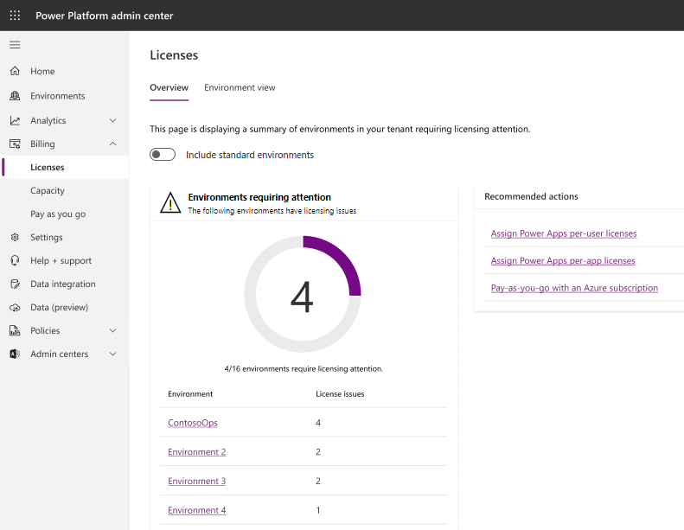
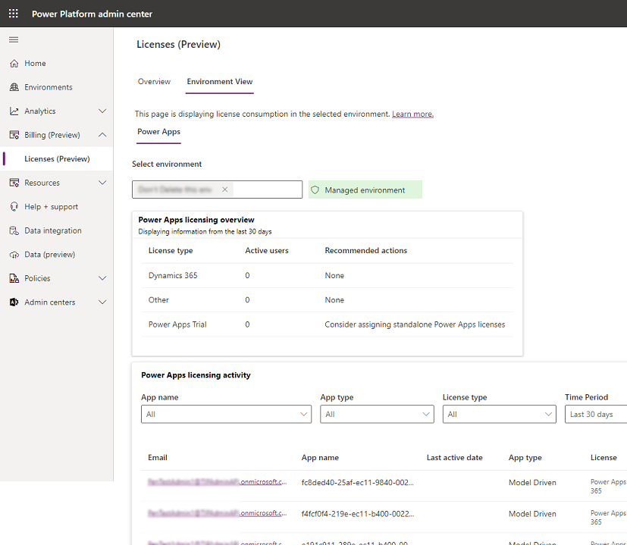
New Licenses reports (Preview)
New Bill (Preview) > Licenses (Preview) option in the left menu in https://aka.ms/PPAC
Overview tab displays a summary of environments in the tenant requiring licensing attention.
Can include standard environments
Environment view displays license consumption in the selected environment.
Get answers to questions like:
How many licenses have been assigned to users?
Which users have these licenses been assigned to?
What type of licenses are users utilizing to launch custom apps?
Which apps are driving which type of license usage?
View license consumption (preview) - Power Platform | Microsoft Learn
Microsoft Confidential

Slide 29
Questions?
Power Platform licensing FAQs - Power Platform | Microsoft Learn

Slide 30
Microsoft
Microsoft Confidential

